Slide 1
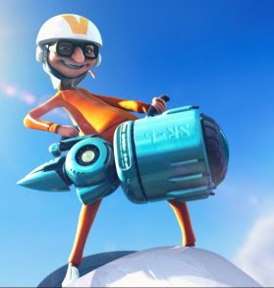
Kinematics in Two Dimensions
This lesson will extend your knowledge of kinematics to two dimensions
You will be able to solve problems involving displacement in two dimensions

Slide 2
Learning Goals
By the end of this lesson, you will be able to:
add vectors in two dimensions using scale diagrams
use vector addition to solve kinematics problems for displacement

Slide 3
Success Criteria
Can I:
add vectors using the head to tail rule
solve for displacement in two dimensions using the scale diagram method

Slide 4
Vector Addition
Recall :
A vector is a quantity that has both magnitude and direction
Vectors are represented as arrows
To add vectors we use the head to tail rule: place the
tail of one vector to the head of the other vector

Slide 5
b
a
b
a
a+b
With vectors the order of addition doesn’t matter.
b
b+a
a
a
a+b
b

Slide 6
The easiest way to calculate the addition of vectors
is by drawing a scale diagram.
To do this, you must use a ruler and protractor.

Slide 7
PRACTICE Problem
What is the addition of 5.0 units [R] plus
3.0 units [D] plus 4.0 units [R45ºD]?
9.8 units [R37ºD]
5.6 units [L32ºU]
12 units [L45ºD]
6.8 units [R45ºD]

Slide 8
Sample Problem
A hiker walks 15 km [N], then 24 km [N60ºW], then
21 km [S]. What is his final displacement?
Sol’n:
8 cm
Draw a scale
diagram
1 cm = 3 km
60º
7 cm
Place vectors head to tail
7 cm
5 cm
This is the total d

Slide 9
Use your ruler and protractor to measure the final
displacement.
Therefore, the hikers final displacement is
21 km [W15ºN].
Don’t forget to apply your scale.

Slide 10
HOMEWORK
Read Section 2.1
Review Tutorial 1 and 2
Questions 1 – 2 pg 61
1 – 2 pg 64
1 – 9 pg 65

